Slide 1


Slide 2

Western University in Collaboration with Scatr Inc: A Two-Phase Novel Drug Checking Initiative
Funding provided by Health Canada’s Substance Use and Addictions Program (SUAP)

Slide 3
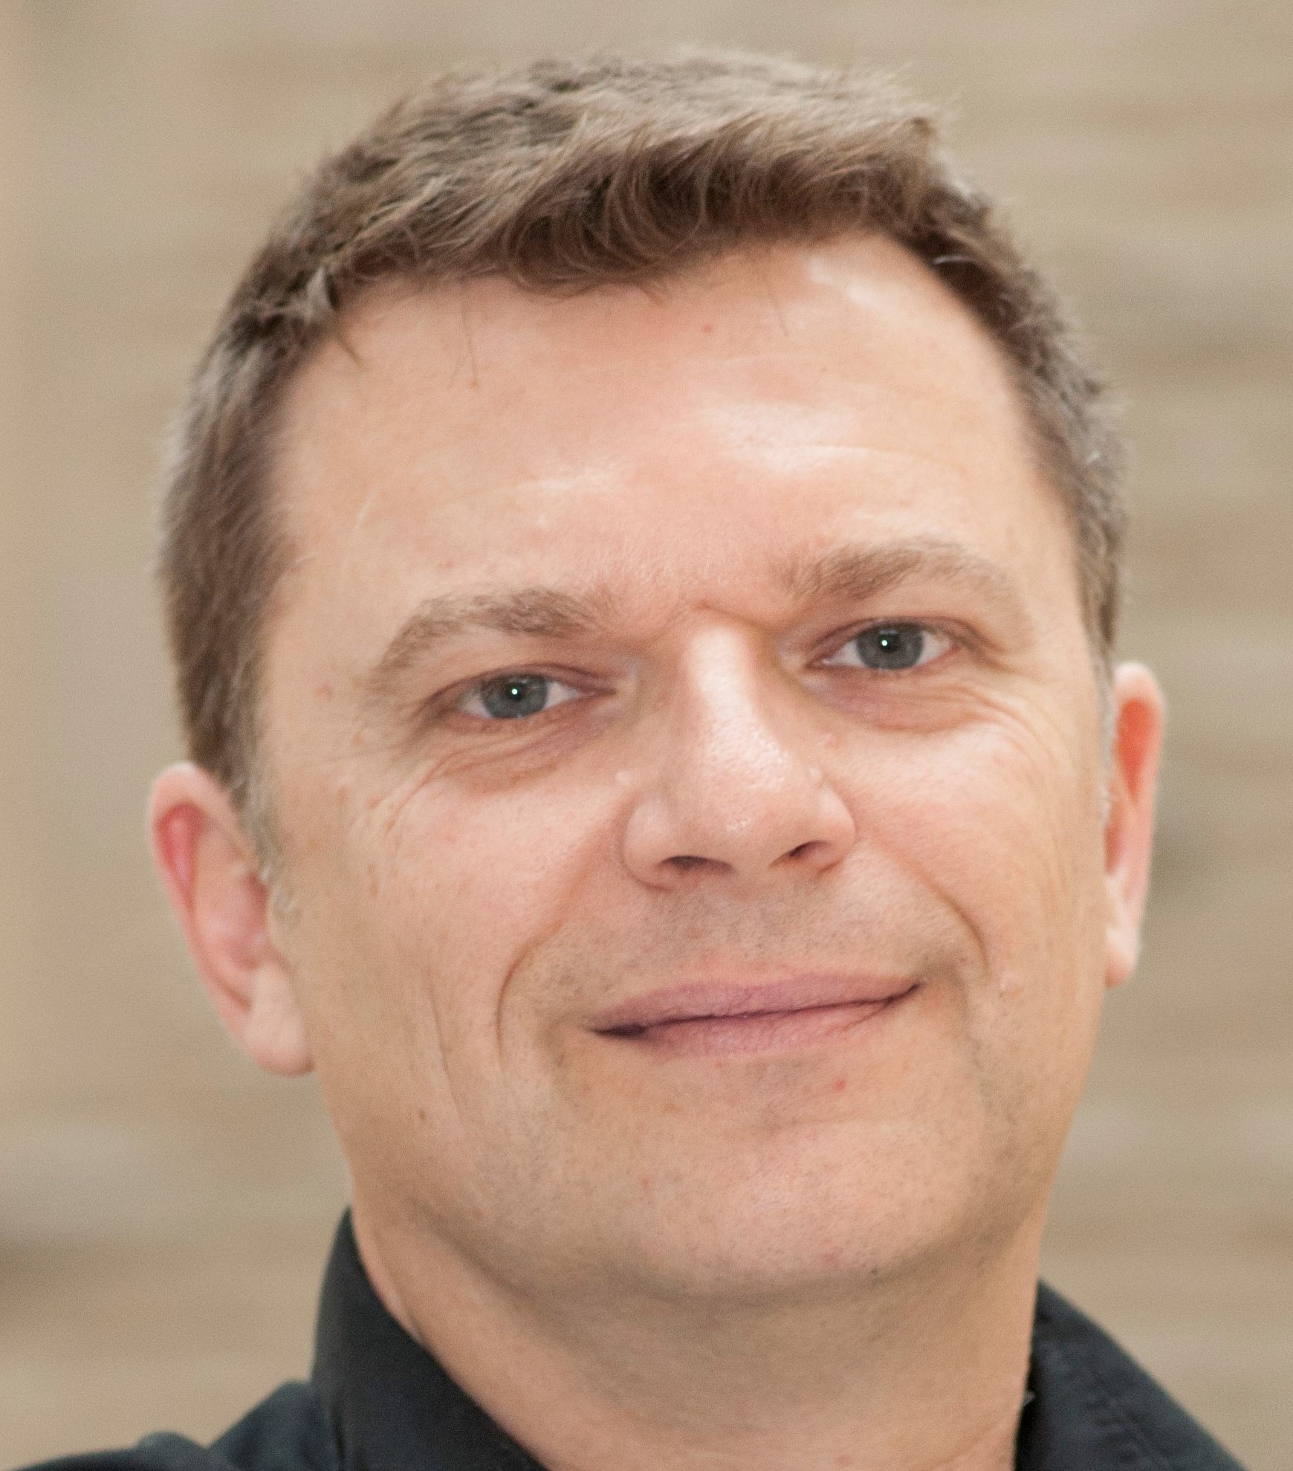


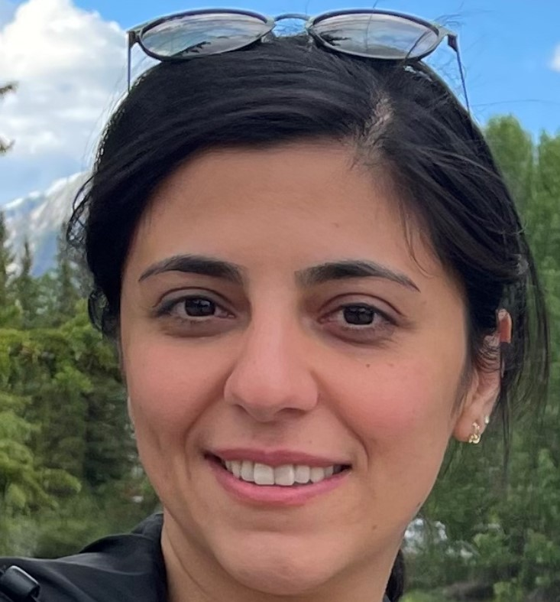



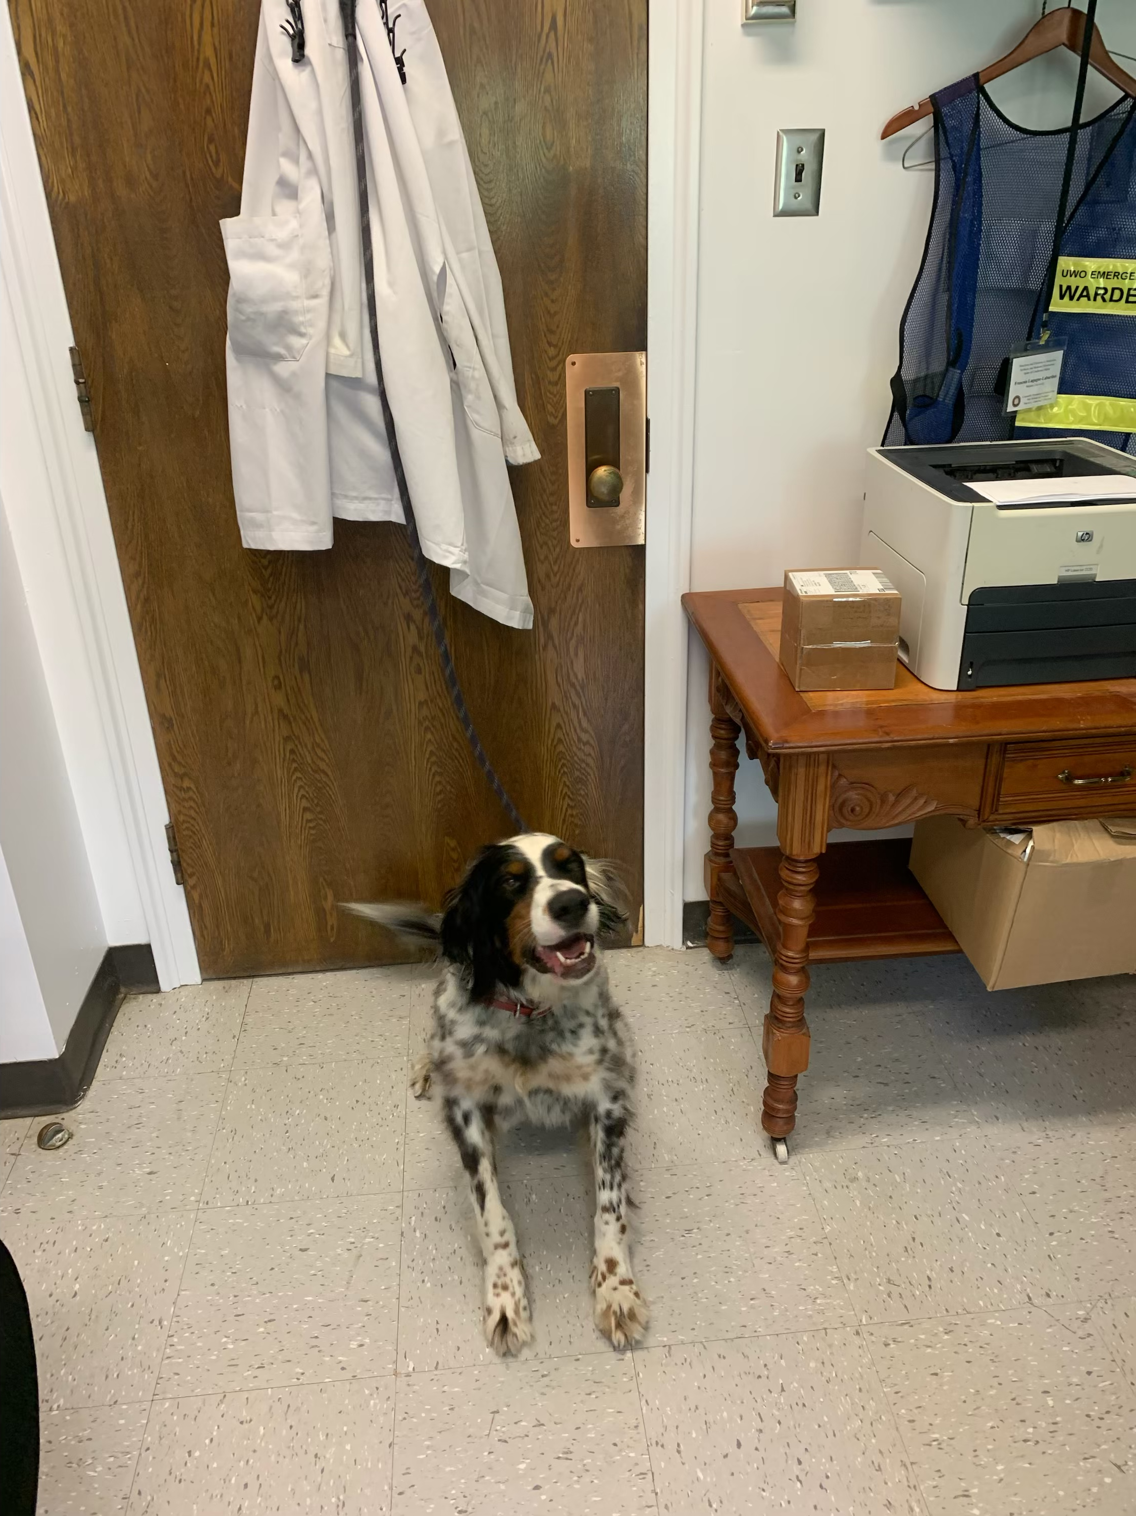
The Western Crew
Prof. Francois Lagugne-Labarthet – Principal Investigator
Dr. Abe Oudshoorn
– Co-Investigator
Dr. Daniel Lizotte
– Co-Investigator
Dr. Elnaz Aliyari
– Post Doctoral Associate
Victoria Primeau
– Graduate Student, PhD Epidemiology
Jesse Cram
– Graduate Student, Master of Health Information Science (MHIS)
River (Lagugne-Labarthet)
– Principal Canine, PhD Human Support
Cameron Brown
– Project Manager
Western University in Collaboration with Scatr Inc: A Two-Phase Novel Drug Checking Initiative

Slide 4




The Scatr Inc Crew
Ari Forman
– Co-Founder and COO
Alex Boukin
– Co-Founder and CTO
Katelyn Melo
– Head of Client Success, Projects and Communications
Alex Chang
– Employee
David
– The Courier
Kee
– Employee
Western University in Collaboration with Scatr Inc: A Two-Phase Novel Drug Checking Initiative

Slide 5

Background
Western University in Collaboration with Scatr Inc: A Two-Phase Novel Drug Checking Initiative

Slide 6

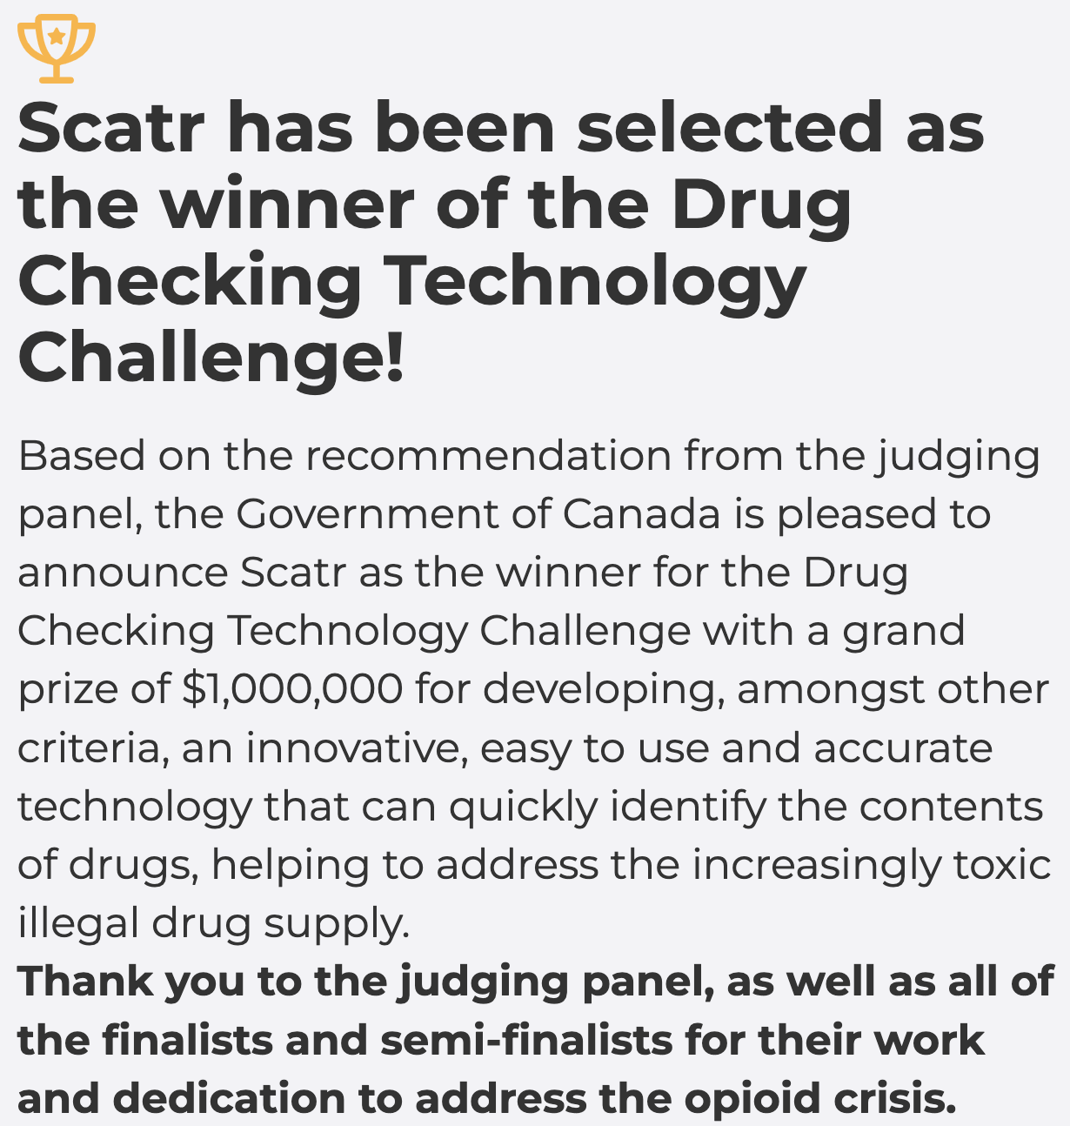



Background
2018
2020
2019
2021
Western University in Collaboration with Scatr Inc: A Two-Phase Novel Drug Checking Initiative

Slide 7



Background
The Community Care and Recovery Act, 2024 (the “CCRA”) received Royal Assent on December 4, 2024.
2022
2024
Present…
Contribution Agreement / Phase #1:
Creating a Drug Checking Network Using Machine Learning Enabled Spectrometers
2023
Contribution & Amending Agreement / Phase #2:
Leading the Way: PWLLE at the Forefront of Drug Checking Initiatives
2025
Western University in Collaboration with Scatr Inc: A Two-Phase Novel Drug Checking Initiative

Slide 8
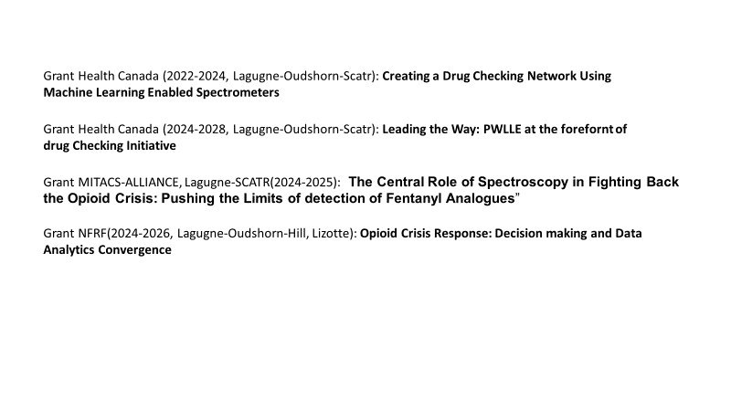
Grant-Related Projects (Western)

Slide 9
Overview
Western University in Collaboration with Scatr Inc: A Two-Phase Novel Drug Checking Initiative

Slide 10
Overview
Phase #1:
Creating a Drug Checking Network Using Machine Learning Enabled Spectrometers
Purpose: To conduct research on the composition of illegal substances tested at 10 supervised consumption sites (SCSs) with Section 56 Exemptions in place; and develop reports and studies to help inform harm reduction service delivery, particularly with respect to drug-checking.
Primary Target Group: People Who Use Drugs (PWUDs), People Who Inject Drugs (PWIDs), as well as people who work with them (‘support workers’).
Methods: Deploy 10 networked spectrometer systems for permanent use at each harm reduction site with an additional device housed at the UWO laboratory. Systems/devices will only become operational once the necessary site-specific exemptions are in place.
Scatr Inc will train harm reduction workers on how to operate the devices, and workers will be responsible for scanning samples from PWUDs. Geolocalized data from the sites will be used to generate real-time reports on drug circulation in Ontario and Canada, respectively. Sharing of anonymous drug-checking data will allow PWUDs to be more informed about their street drugs.
Phase #2:
Leading the Way: PWLLE at the Forefront of Drug Checking Initiative
Purpose: To integrate people with lived and living experience (PWLLE) into drug-checking initiatives in supervised consumption sites (SCSs), harm reduction centres and public health clinics in Canada.
Primary Target Group: PWLLE working in substance use.
Methods: The project team will work with PWLLE to enhance current approaches to drug-checking. PWLLE will be consulted to help develop effective communication and training materials. Their feedback will be used to improve project outcomes by customizing drug-checking services across participating sites. PWLLE will also be trained in drug-checking technologies and methodologies to enable them to lead and implement drug-checking initiatives and training programs at other appropriate sites.
Deploy 13 new drug-checking devices implemented with the PWLLE feedback included in the software and training material updates.
This project acknowledges that needs may be different in distinct locations and communities, as well as from the service providers (SCSs, paramedics, festival organizers), and will focus on customized solutions. The final phase is evaluation and research to determine the impact of these interventions on current practices in the drug-checking space.
Western University in Collaboration with Scatr Inc: A Two-Phase Novel Drug Checking Initiative

Slide 11
Overview
Phase #1:
Creating a Drug Checking Network Using Machine Learning Enabled Spectrometers
Timeline:
Start: April 1st, 2022 End: March 31st, 2024
Deliverables/Output:
2022-2023:
Deploy 10 devices at 10 (+1) SCSs w/ proven Section 56 Exemption.
Provide SCSs staff with hands-on device-specific training.
Setup Drug-checking Laboratory at Western University (HPLC-MS, FTIR, Scatr Series One).
Perform HPLC-MS drug-checking on donated samples from SCSs & Measure effectiveness of networked drug-checking devices.
2023-2024:
Limit of Detection (LOD) and Limit of Quantification (LOQ) investigations.
Ongoing HPLC-MS drug-checking on donated samples from SCSs & Ongoing measurement of effectiveness of networked drug-checking.
Drug Trend Report & share data with existing network.
Investigate similar samples comparison tool and related Early Warning System Efficacy Report.
Drug-checking Social Impact Report via SCSs surveys
Drug-checking Efficacy Report via analyses of behavior trends.
Phase #2:
Leading the Way: PWLLE at the Forefront of Drug Checking Initiative
Timeline:
Start: June 27th, 2024 End: March 31st, 2028
Deliverables/Output:
2024-2025:
Selection of 13 new participating sites.
Ensure continuity w/ existing 10 sites; and ongoing evaluation of Scatr device usage and placement.
Relevant Exemption 56 updates/submissions.
Consultations & Focus Groups w/ PWLLEs and subsequent development of educational/communication modules and strategies for drug-checking; compensated feedback to be provided.
Ongoing hands-on drug-checking training & additional Drug-Checking Peer (DCP) Training & Certification Course.
Deploying and/or re-deploying 3 additional Scatr devices to UWO, Ottawa and Niagara.
2025-2026:
9 drug-checking devices delivered w/ hands-on training.
Ongoing Drug-Checking Peer (DCP) Training & Certification Course.
Iterative inclusion of PWLLE feedback into DCP Training & Certification Course & device software
Present…
Western University in Collaboration with Scatr Inc: A Two-Phase Novel Drug Checking Initiative

Slide 12
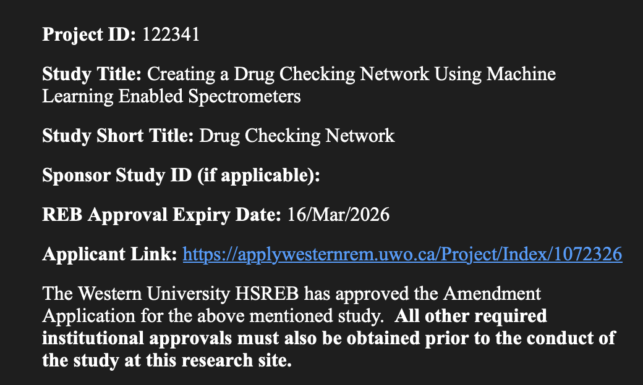
HSREB
Western University in Collaboration with Scatr Inc: A Two-Phase Novel Drug Checking Initiative

Slide 13
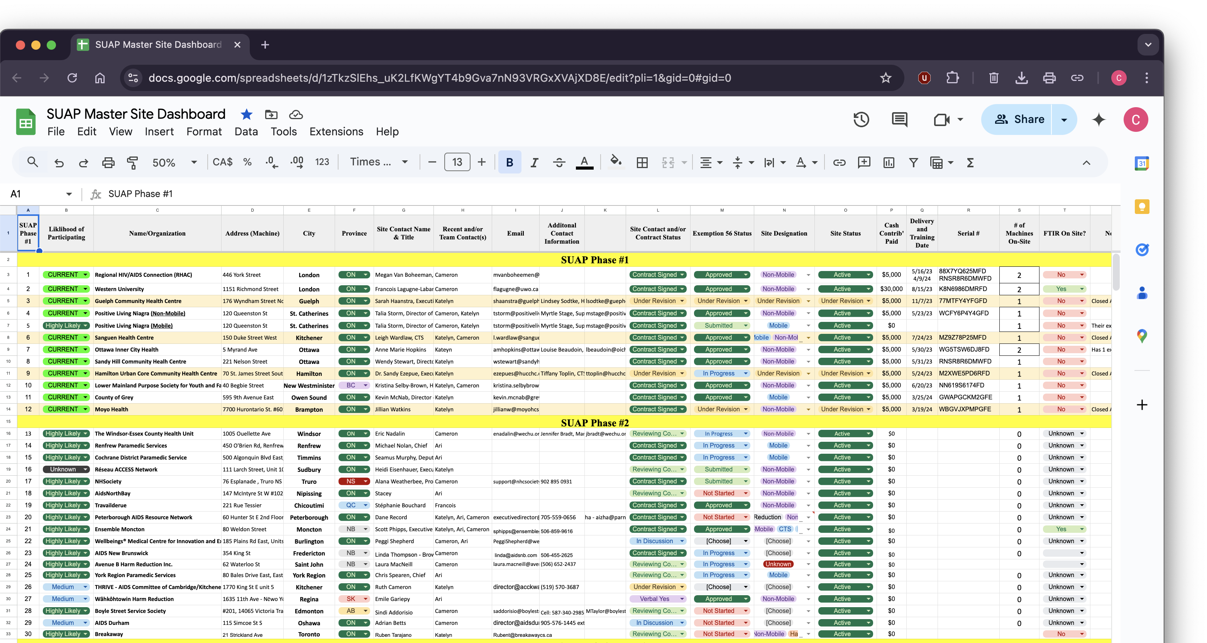
Partners
Western University in Collaboration with Scatr Inc: A Two-Phase Novel Drug Checking Initiative

Slide 14
Overview
Phase #2:
Leading the Way: PWLLE at the Forefront of Drug Checking Initiative
Timeline:
Start: June 27th, 2024 End: March 31st, 2028
Deliverables/Output:
2026-2027:
Selection of 2 new participating sites and device delivery.
Ongoing hands-on drug-checking training & Drug-Checking Peer (DCP) Training & Certification Course, inclusive of PWLLE feedback.
Ensure continuity w/ existing 23 sites; and ongoing evaluation of Scatr device usage and placement.
Relevant Exemption 56 updates/submissions.
2027-2028:
Selection of 2 new participating sites and device delivery.
Ongoing hands-on drug-checking training & Drug-Checking Peer (DCP) Training & Certification Course, inclusive of PWLLE feedback.
Ensure continuity w/ existing 25 sites; and ongoing evaluation of Scatr device usage and placement.
Relevant Exemption 56 updates/submissions.
Final feedback, research and incorporation phase – collection and analysis of data from all 25 participating sites and PWLLEs.
Research manuscript regarding project strategies used to enhance future drug-checking initiatives.
Present…
Western University in Collaboration with Scatr Inc: A Two-Phase Novel Drug Checking Initiative

Slide 15
Data Collection & Analysis
Western University in Collaboration with Scatr Inc: A Two-Phase Novel Drug Checking Initiative

Slide 16
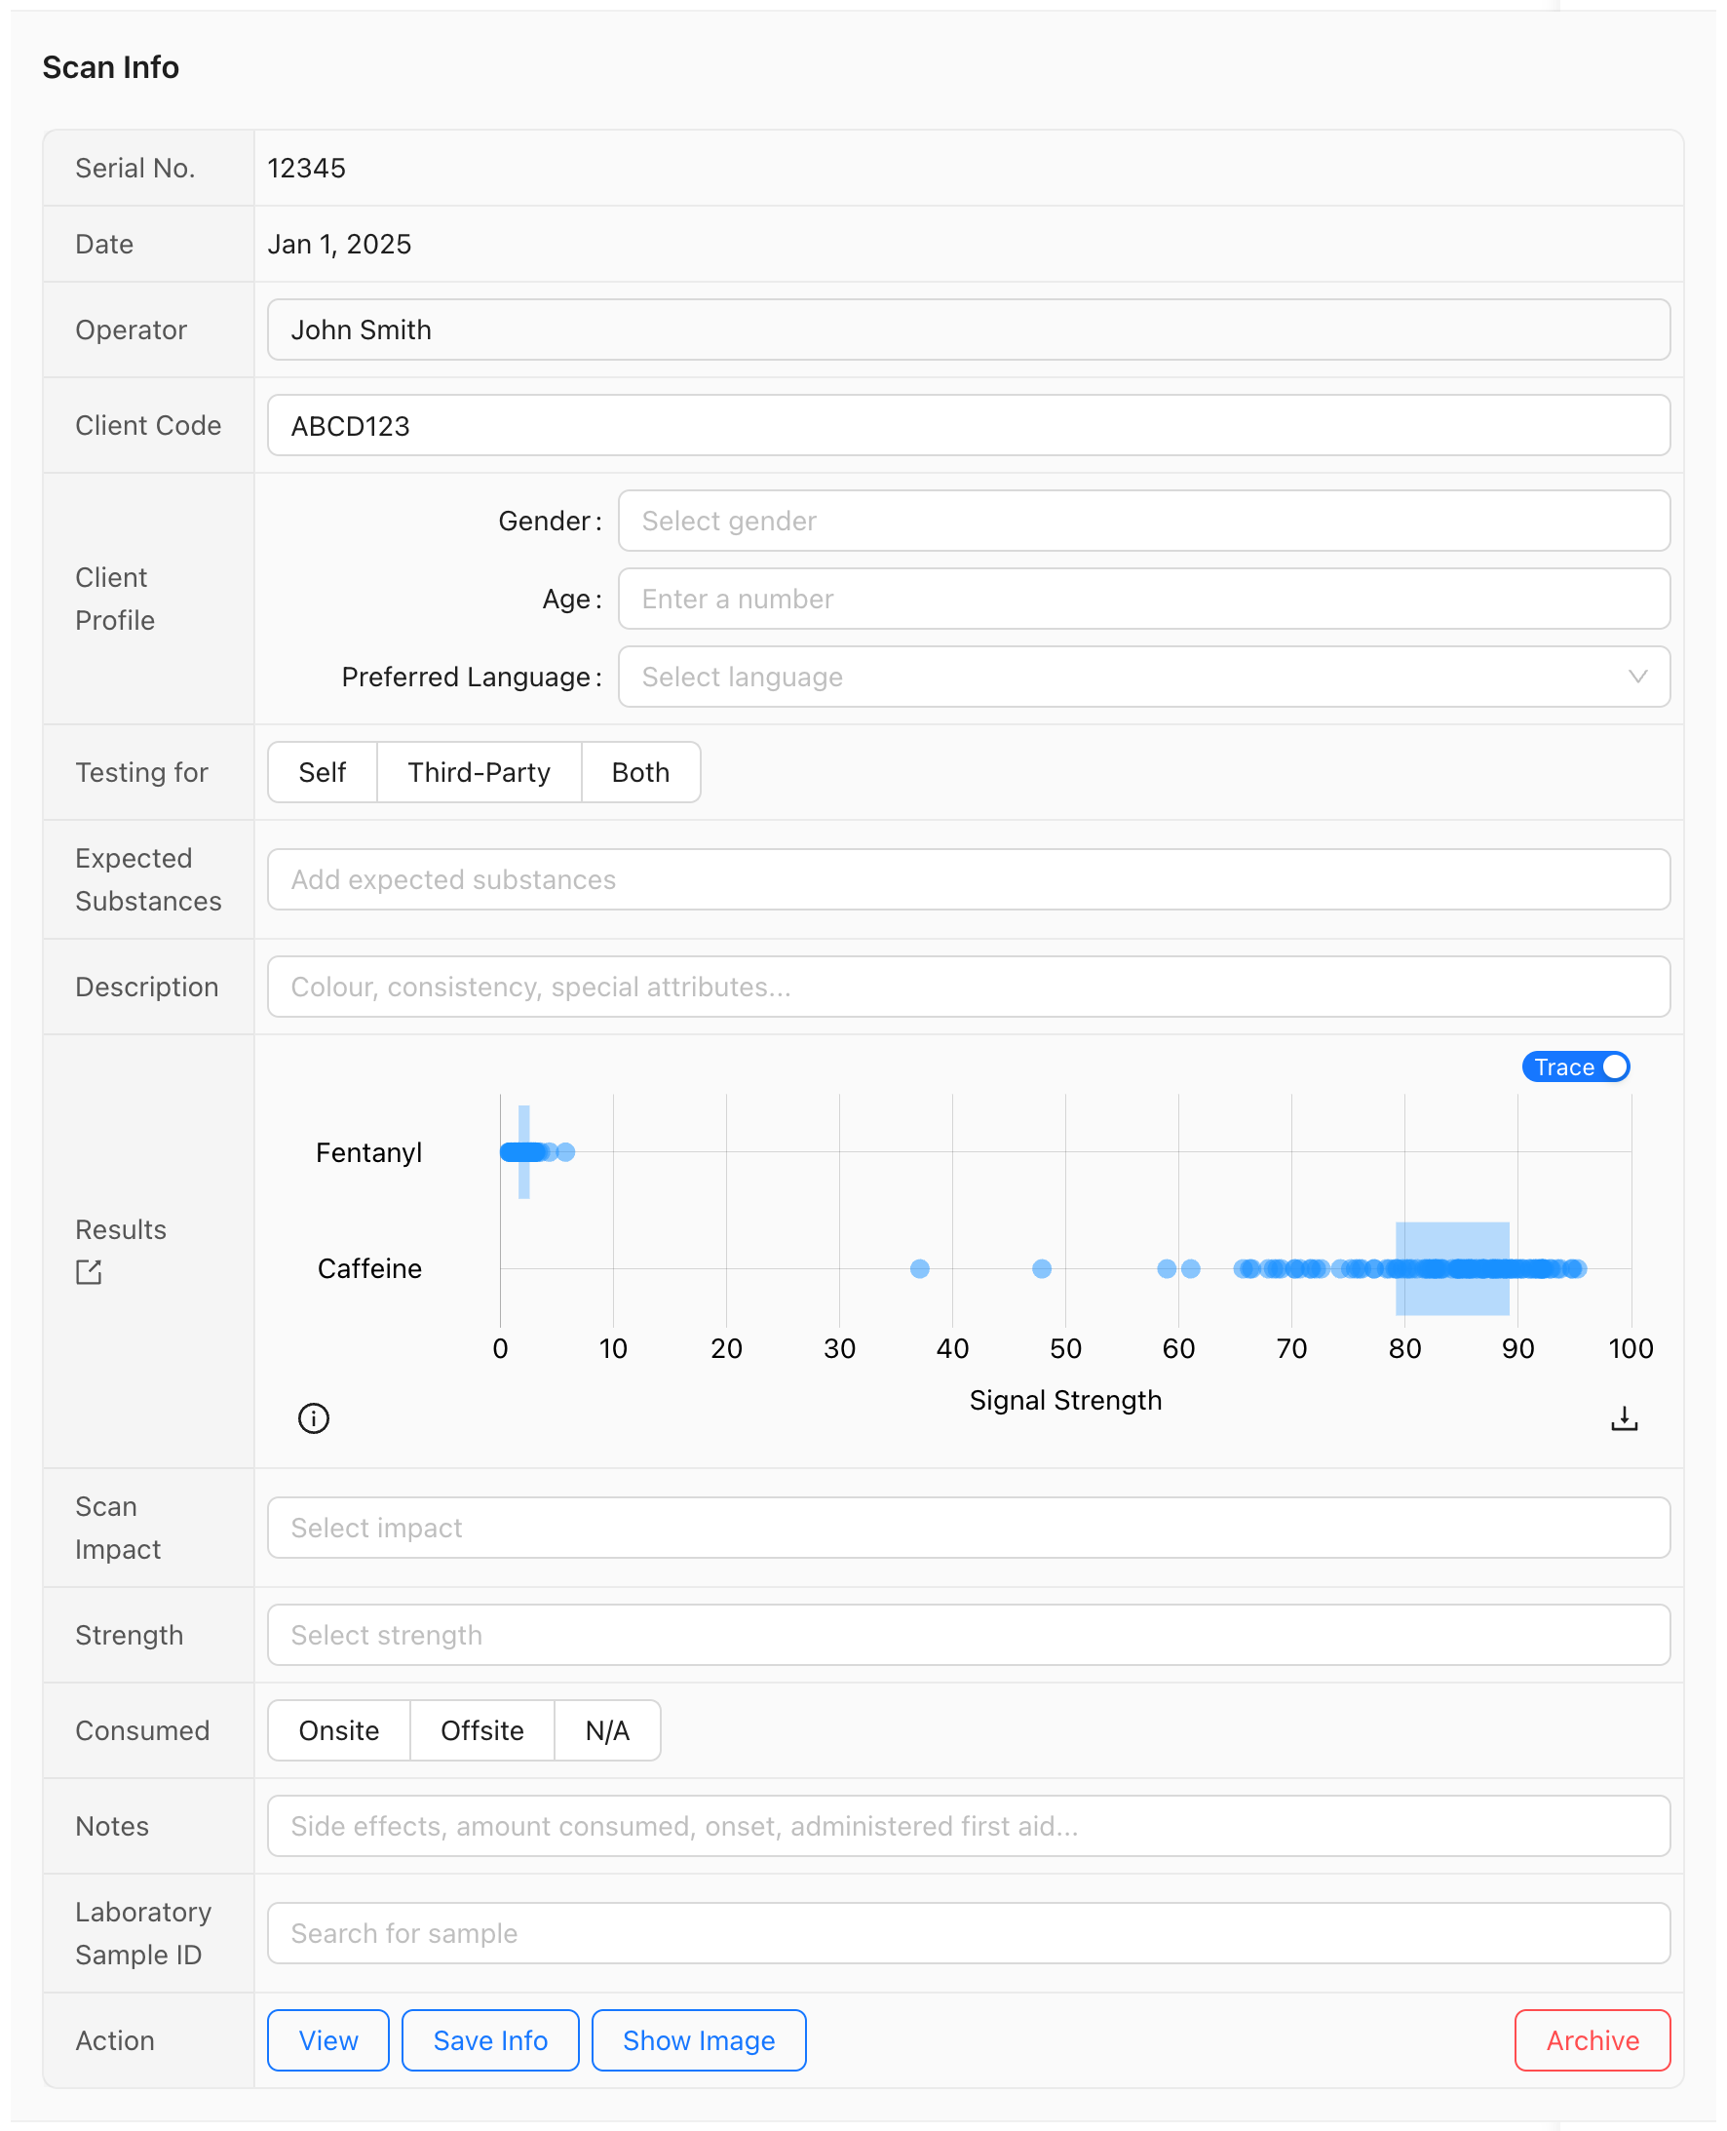

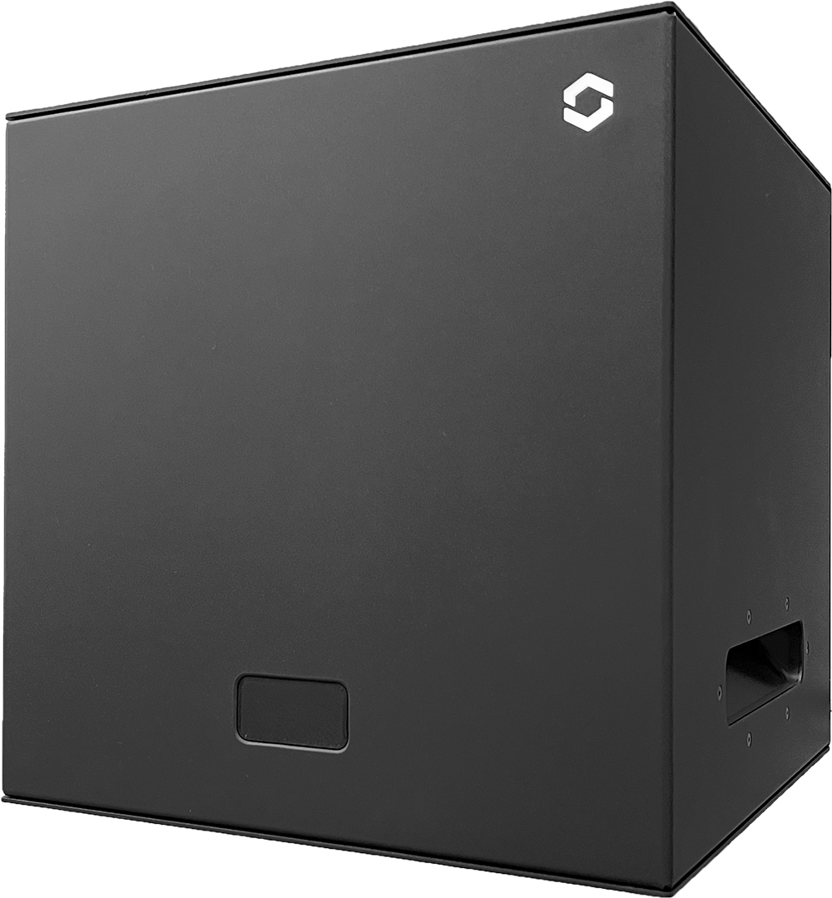

Data Collection & Analysis
A)
Western University in Collaboration with Scatr Inc: A Two-Phase Novel Drug Checking Initiative

Slide 17





Data Collection & Analysis
B)
PWLLE Consultations
Consultation Feedback
PWLLE Drug-Checking Peer (DCP) Training & Certification Course
Pre- and Post-Course Surveys
Western University in Collaboration with Scatr Inc: A Two-Phase Novel Drug Checking Initiative

Slide 18
Data Collection & Analysis
A)
Pre-Scan/User Interface
Serial #
Date
Operator
Client Code
Age
Gender (List))
Live w/ chronic pain (Y/N)
Identify as Indigenous (Y/N)
Identify as Black, racialized or person of colour (Y/N)
Identify at LGBTQ or another minority orientation (Y/N)
Preferred language (List)
Testing for (Category)
Expected Substance (List)
Description (Open)
Scan impact (Likert)
Strength (Likert)
Consumed (Category)
Further notes on sample (Open)
Post-Scan/Results
Signal Strength
B)
PRE-COURSE SURVEY
Age
Residence (City/Town)
Gender
Identify as 2SLGBTQIA+ (Y/N)
Race/Ethnicity
Familiarity w/ drug-checking technology (Likert)
Prior participation in drug-checking initiatives (Y/N)
Do you find it easy to access to resources (Y/N)
Confidence in applying hard reduction strategies (NRS, 1-5)
Confidence to effectively communicate about drug-checking w/ others (NRS, 1-5)
Current involvement in any substance use education/harm reduction initiatives (Y/N)
Rating of importance of involving PWLLE in drug-checking initiatives (Likert)
Barries in accessing drug-checking services (Open)
POST-COURSE SURVEY
Rating of understanding of drug-checking technologies after the course (Likert)
Confidence in applying hard reduction strategies (NRS, 1-5)
Confidence to effectively communicate about drug-checking w/ others (NRS, 1-5)
Program influence on potential involvement in substance use education or harm reduction initiatives (Likert)
Would you seek future employment in harm reduction services (Y/N)
Did training materials and workshop meet expectations (Y/N)
What changes would you suggest (Open)
Is there any way the drug-checking process can be improved to meet your individual needs (Open)
Has your opinion changed on the importance of PWLLE involvement in drug–checking (Likert)
Rating of importance of involving PWLLE in drug-checking initiatives (Likert)
Feel equipped to lead or contribute to drug-checking initiatives ((Y/N)
Any additional feedback or suggestions regarding the program (Open)
Western University in Collaboration with Scatr Inc: A Two-Phase Novel Drug Checking Initiative

Slide 19
Data Collection & Analysis
Phase #1 Short-Term Outcomes Summary:
Creating a Drug Checking Network Using Machine Learning Enabled Spectrometers
Primary target population have access to information on substance
A) # of participants reached in substance use-related learning opportunities delivered by SUAP funded project
Project Indicator) # of substance user’s drug samples checked at all sites.
B) % of primary target population who reported that they gained knowledge/skills about substances as a result of the SUAP funded project.
Project Indicator) % of PWUDS and PWIDs who indicated that they gained knowledge about their substance following analysis.
Increased availability of harm reduction services
A) # of new services offered by SUAP funded projects (including type of service).
Project Indicator) # of new drug-checking services at the sites.
B) # of participants accessing services offered by SUAP funded project.
Project Indicator) # of participants testing their substance prior to consumption.
Phase #1 Medium-Term Outcomes Summary:
Creating a Drug Checking Network Using Machine Learning Enabled Spectrometers
Increased availability of harm reduction services
A) % of targeted Canadians who reported they used knowledge/skills related to substance use provided by SUAP funded project.
Project Indicator) % of substance users who reported that they chose safer use due to the information they learned from the drug checking.
B) % of targeted Canadians who reported that they intend to use knowledge/skills related to substance use provided by SUAP funded project.
Project Indicator) % of substance users indicating that the provided data will influence their use of substances.
C) % of participants in SUAP funded treatment and/or harm reduction services projects reporting a positive behaviour/health outcome.
Project Indicator) % of participants reporting positive change in their substance consumption.
Western University in Collaboration with Scatr Inc: A Two-Phase Novel Drug Checking Initiative

Slide 20
Data Collection & Analysis
Phase #2 Short-Term Outcomes Summary:
Leading the Way: PWLLE at the Forefront of Drug Checking Initiative
Primary target population have access to information on substance use A) # of participants from the primary target population reached in substance use-related capacity building opportunities delivered by SUAP funded project.
Project Indicator) # of PWLLE working in substance use reached by substance use-related capacity building opportunities.
B) % of participants surveyed at capacity building opportunities that reported increased capacity (i.e., ability to apply what they learned) to address substance use in their role (e.g., comfort, confidence, leadership)
Project Indicator) % of PWLLE who attend focus groups/consultations and/or training sessions that learn the background and operation of Scatr devices to perform drug checking, and how to communicate the results to PWUD.
C) # of people from the target population who were engaged in informing, developing or leading elements of this project.
Project Indicator) # of PWLLE engaged with enhancing the use of drug-checking technology.
Phase #2 Medium-Term Outcomes Summary:
Leading the Way: PWLLE at the Forefront of Drug Checking Initiative
Increased availability of harm reduction services
A) % of target population surveyed who intend to use the tool/resource/guidance provided.
Project Indicator) % of PWLLEs working in substance use that attended Peer Training and Certification sessions who intend to use gained knowledge in their harm reduction and practices.
Western University in Collaboration with Scatr Inc: A Two-Phase Novel Drug Checking Initiative

Slide 21
Data Products
Cram, J., Koncovy, J., Oudshoorn, A., Brown, C., Lagugne-Labarthet, F. Druck-Checking Results Using AI-Enabled Raman Spectrometry in a Canadian Drug-Checking Network [May 2023 – September 2024]. (Single Report) HEALTH CANADA
Aliyari, E., Boheeman, MV., Salasidis C., Stom, T., Hopkins, AM., Favics, N., McAndrew, R., Haanstra, S., McNab, K., Watkins, J., Pham, A., Oudshoorn, A., Brown, C., Lagugne-Labarthet, F. Street Drug Monitoring with Networked Spectrometers Powered by Machine Learning: A Pilot Study in Ontario, Canada. (Single Report)
Primeau, V., Lizotte, D., et al. Paper. (Single Report)*
HPLC-MS vs Scatr Series One – Comparative Results Reports (Reported Monthly)
Site Usage Report (# of unique scans per site/month) (Reported Monthly)
Performance Measurement and Evaluation Plan / Performance and Progress Report (Reported Semi-Annually) HEALTH CANADA
Annual Plan (Reported Semi-Annually) HEALTH CANADA
Financial Reports HEALTH CANADA
Western University in Collaboration with Scatr Inc: A Two-Phase Novel Drug Checking Initiative

Slide 22
Data Products Defined
Cram, J., Koncovy, J., Oudshoorn, A., Brown, C., Lagugne-Labarthet, F. Druck-Checking Results Using AI-Enabled Raman Spectrometry in a Canadian Drug-Checking Network [May 2023 – September 2024]. (Single Report)
METHODS: Narrative Review - reporting on 10 networked Scatr Series One devices over a 16-month period from May 21st, 2023, to Sept 17th, 2024; 6998 scans by 4024 participants. Descriptive statistics and select subjective participant feedback is reported on.
ANALYSIS/OUTPUT:
Participant-reported sociodemographics
Participants/Scans by site (Absolute)
Expected vs Detected results (Descriptive)
Top 20 detected drugs & fillers by site (Absolute)
Impact of Awareness (Participant-reported consumption-related behavior) - (Absolute / %) AND Select subjective participant feedback quotes
Limitations
Western University in Collaboration with Scatr Inc: A Two-Phase Novel Drug Checking Initiative

Slide 23
Data Products Defined
Aliyari, E., Boheeman, MV., Salasidis C., Stom, T., Hopkins, AM., Favics, N., McAndrew, R., Haanstra, S., McNab, K., Watkins, J., Pham, A., Oudshoorn, A., Brown, C., Lagugne-Labarthet, F. Street Drug Monitoring with Networked Spectrometers Powered by Machine Learning: A Pilot Study in Ontario, Canada.
METHODS: Reporting on 10 networked Scatr Series One devices over a 16-month period from May 2023 to August 2024; 8523 samples/substances provided by 5200 participants. On selected samples HPLC-MS measurements were collected to assess the Scatr Series One comparative results. Subjective participant feedback is also reported on.
ANALYSIS/OUTPUT:
Expected vs Detected - (Absolute / Sankey Diagrams)
Qualitative Performance Validation; Standard Confusion Matrix (SCM)
False Negative Rate (FNR), False Positive Rate (FPR), Precision (PPV, Positive Post-Test Probability), Accuracy
Quantification Difference; Series One vs HPLC-MS - ‘Error-Range of 0 to ± 10%’ (Frequency / %)
Series One Detection Frequency - (Absolute / Prevalence)
N of 1 Case Report Example
Limit of Detection (LOD) & Limit of Quantification (LOQ) - (The Mann-Whitney U Test)
Impact of Awareness (Participant-reported consumption-related behavior) - (Absolute / %)
Western University in Collaboration with Scatr Inc: A Two-Phase Novel Drug Checking Initiative

Slide 24
Victoria and Dan – Research Questions
Data Products Defined
How do patterns of SCATR use and observed substances change across person, place, and time?
Data: Quantitative, logged SCATR data
Methods: biostatistics, machine learning, geomatics, visual analytics
How do client and contextual factors and substance types influence decision-making after receiving drug checking results?
Data: Quantitative SCATR + Qualitative interviews w/advisory board
Methods: As above, TBD qualitative (e.g. grounded theory, ethnography)
How can and should information from drug checking services inform provider-level and organization-level service provision activities?
Data: Qualitative, interviews w/advisory board
Methods: TBD (e.g. grounded theory, ethnography)

